Slide 1

Doctor Visit Analytics
Name: Ayush Kumar
Course / Batch: VOIS AICTE Batch 1 (2026-2027)
Student Id: STU6a624b1fd56521784826655

Slide 2

PROBLEM STATEMENT
Healthcare operational managers face significant challenges due to unmonitored patient wait times, unpredictable medical visit costs, and inefficient allocation of medical staff across specialties. Without actionable data insights, clinics experience extended wait times, inconsistent billing patterns, and unbalanced resource distribution—ultimately leading to reduced patient satisfaction and administrative inefficiencies.

Slide 3
Project Description
The Doctor Visit Analytics is an end-to-end Python-based data science solution developed in Google Colab. Designed to address key administrative and financial challenges in modern healthcare settings, this project transforms raw, unorganized patient visit records into high-value operational insights and predictive financial intelligence.
The pipeline spans the entire data lifecycle: generating synthetic clinical datasets, executing systematic data cleaning and sanitization, building dynamic interactive visualizations with Plotly, and training a Random Forest Regressor to forecast doctor visit costs.

Slide 4

WHO ARE THE END USERS?
The primary end users for the Healthcare Analytics for Doctor Visits project fall into four key stakeholder groups:
Healthcare Operations & Clinic Managers: Monitor patient wait times, track daily visit volumes per specialty, and optimize staffing schedules to reduce queue bottlenecks.
Hospital Executive Leadership: Review high-level departmental trends, financial performance summaries, and overall facility capacity metrics to guide strategic planning.
Billing & Financial Analysts: Analyze medical cost distributions across specialties and leverage machine learning predictions to improve billing transparency and price estimations.
Data Analysts & Health Informatics Teams: Maintain the data engineering pipeline, run quality assurance checks on incoming clinical data, and expand machine learning models for deeper operational insights.

Slide 5

Technology Used
Language & Environment: Python 3.x, Google Colab
Data Manipulation: pandas, numpy
Visualization: plotly, matplotlib, seaborn
Machine Learning: scikit-learn (Random Forest Regressor, Train-Test Split, Model Evaluation Metrics)

Slide 6
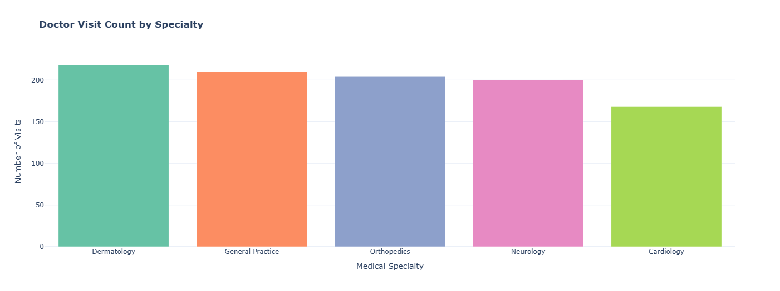
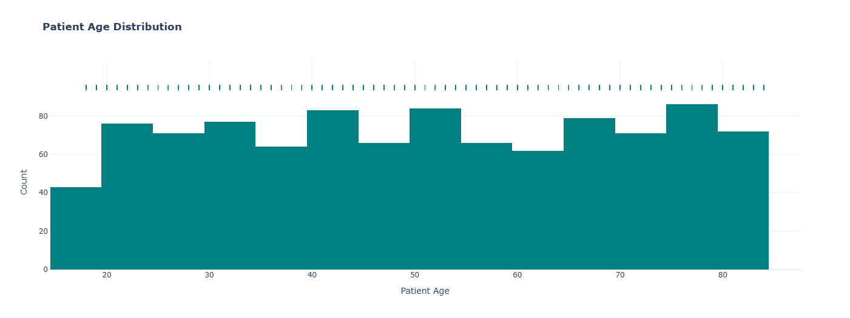
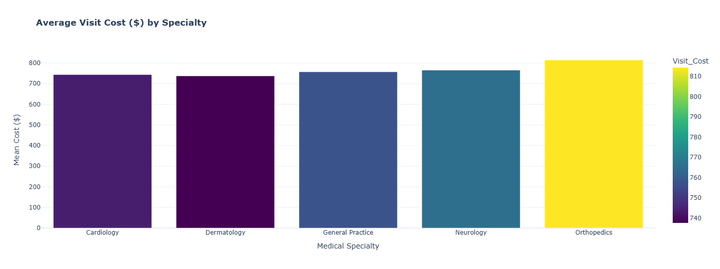
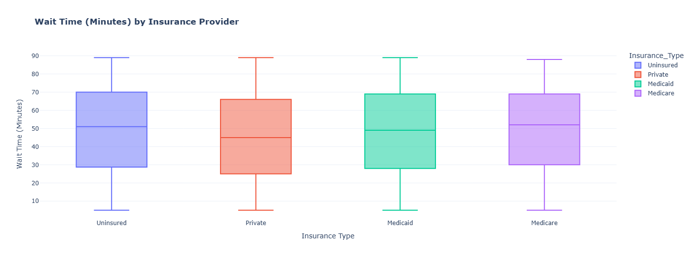
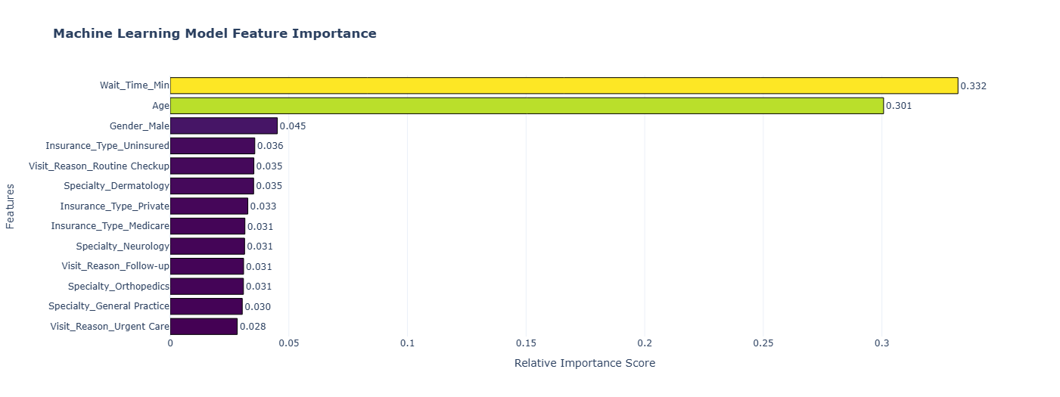
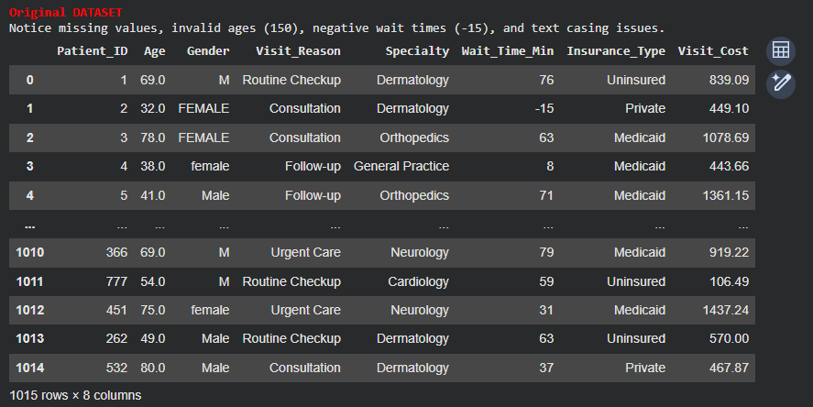
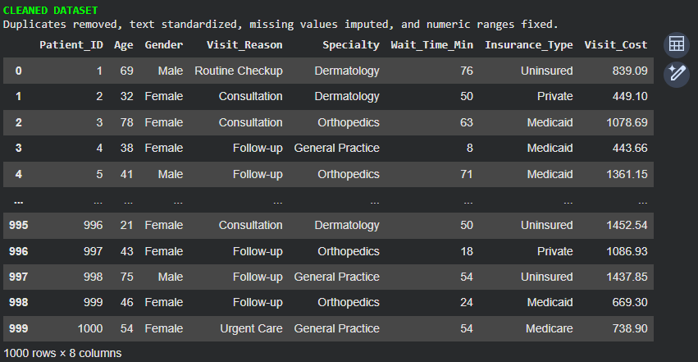
RESULTS

Slide 7
RESULTS

Slide 8
RESULTS

Slide 9
RESULTS

Slide 10
RESULTS

Slide 11
Links for the project

Slide 12
Thank you
.
.

